Slide 1
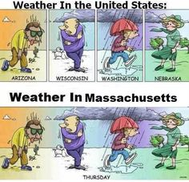
Credit - Pinterest

Slide 2
AM207 Final Project Bayesian Hierarchical Modelling of Rainfall Volume
Victor Lei, Charles Liu, Leonhard Spiegelberg, Vinay Subbiah
Notes:
We also looked at rainfall volume. That is, when it rains, how MUCH does it rain?

Slide 3
Basic Gamma distribution
37
Notes:
Traditionally, daily rainfall volume has been modelled as a straight forward Gamma distribution. If we do this and fit the data for the rainy city of New Bedford, the mean of the Gamma distribution is around 0.37 inches per day.
But clearly, something is not being captured here; precipitation in the early part of the year differs from the latter part.
#We started by picking a city that rains a large amount so we have some sizeable data to work with. New Bedford was a good candidate #so we focused on the 2015 data.
#And this makes sense since different seasons probably produce different amounts of rain.

Slide 4
Switching point
Switching point
207th day
53
25
Notes:
Our idea is to create a variable switching point and then fit two Gamma distributions. Analytically, solving this would be very complex, but using computational MCMC methods, we find the best fit occurs with a switching point at day 207 with a statistically significant difference between the means of the two distributions.
# There are many ideas to extend this basic model, and

Slide 5
Bayesian Networks
Infer Precipitation From Local Regions

Slide 6
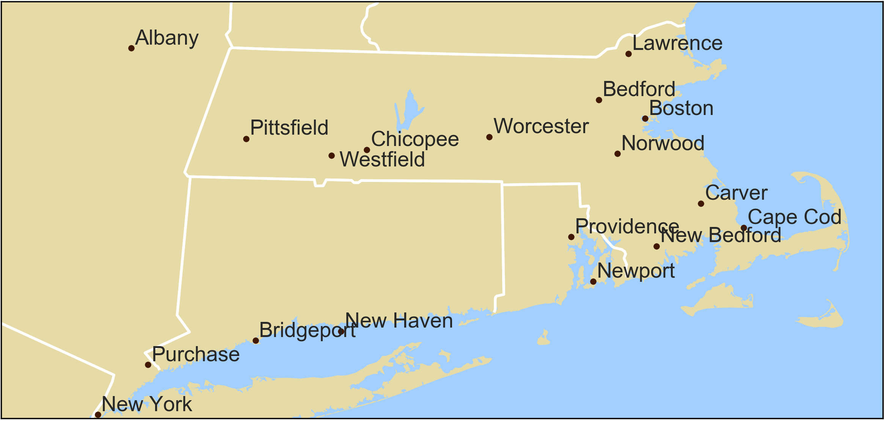
18 Regions

Slide 7
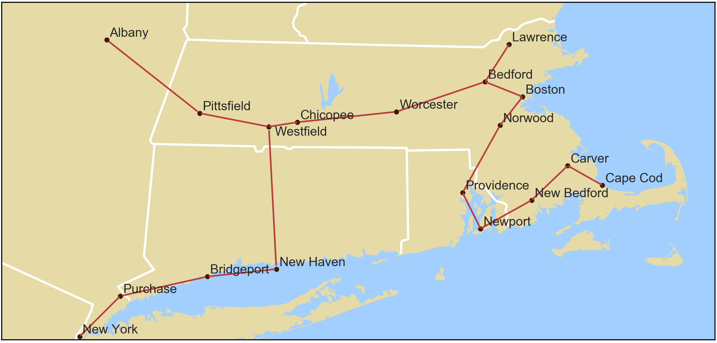
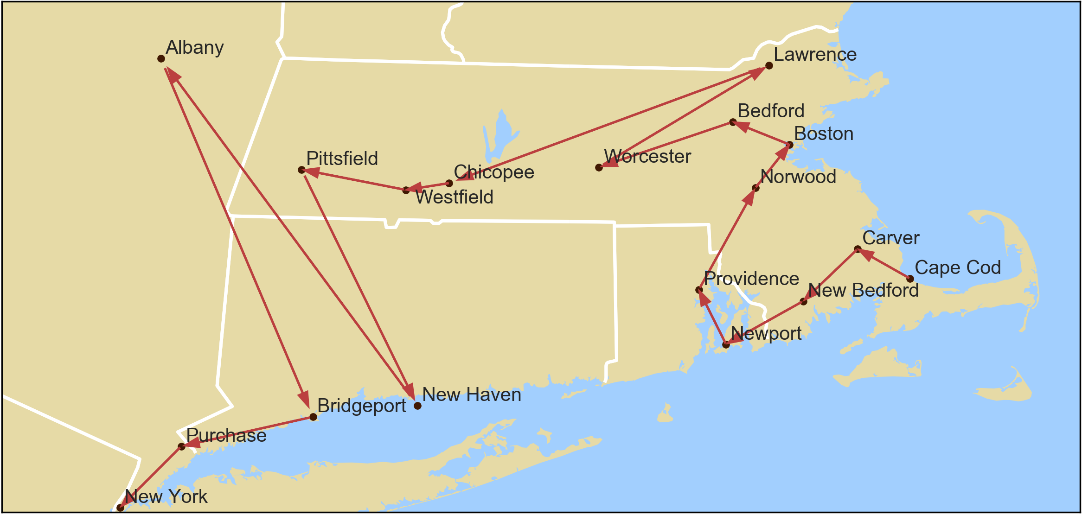
BFS on Minimum Spanning Tree

Slide 8
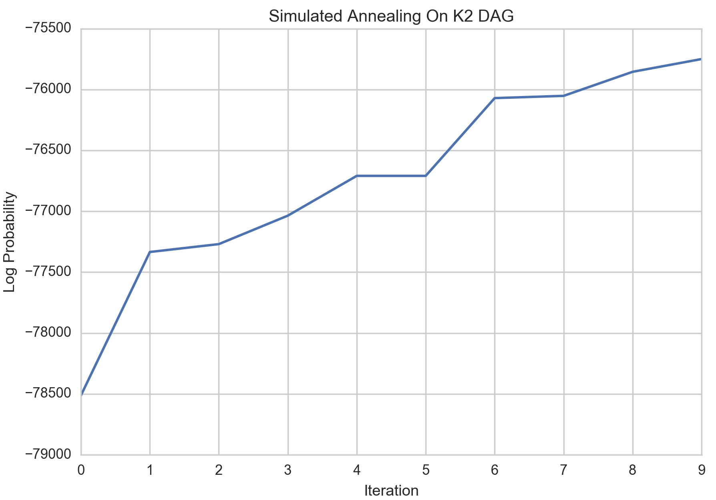
K2 Algorithm + Simulated Annealing
Greedy Algorithm based on heuristics from ordering
For given node
Have base probability when node has no parents
Select best node preceding it in ordering that maximizes probability
If probability improved, keep parent and continue
Otherwise go to next node
Ran SA starting from K2 result

Slide 9
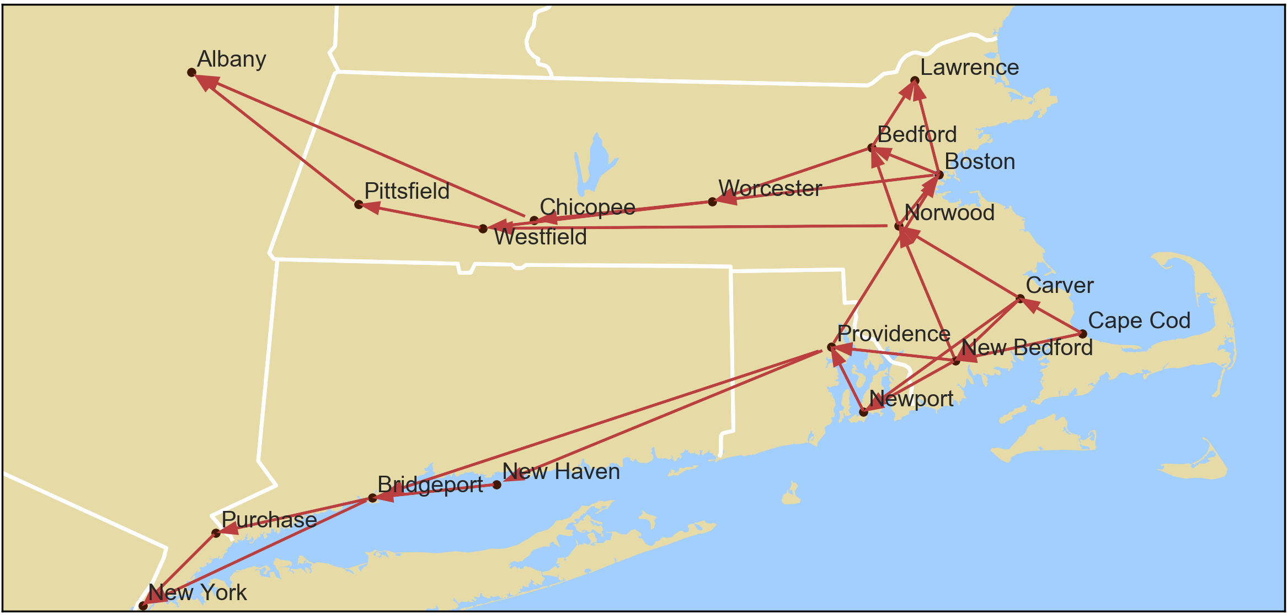
Resulting Structure

Slide 10
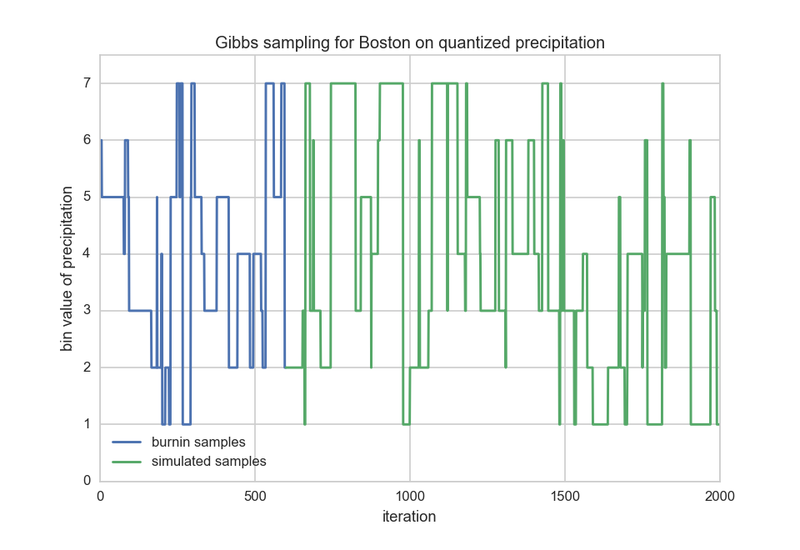
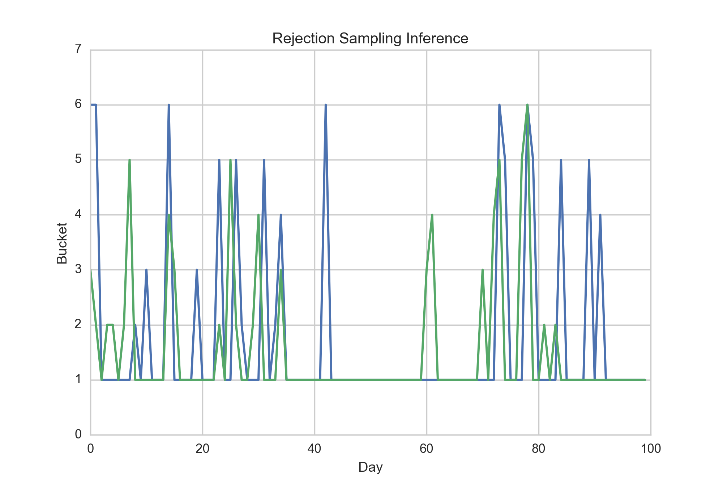
Inference Methods

Slide 11
Bayesian Hierarchical Modelling of Rainfall Volume
Notes:
We also looked at rainfall volume. That is, when it rains, how MUCH does it rain?

Slide 12
Basic Gamma distribution
37
Notes:
Traditionally, daily rainfall volume has been modelled as a straight forward Gamma distribution. If we do this and fit the data for the rainy city of New Bedford, the mean of the Gamma distribution is around 0.37 inches per day.
But clearly, something is not being captured here; precipitation in the early part of the year differs from the latter part.
#We started by picking a city that rains a large amount so we have some sizeable data to work with. New Bedford was a good candidate #so we focused on the 2015 data.
#And this makes sense since different seasons probably produce different amounts of rain.

Slide 13
Switching point
Switching point
207th day
53
25
Notes:
Our idea is to create a variable switching point and then fit two Gamma distributions. Analytically, solving this would be very complex, but using computational MCMC methods, we find the best fit occurs with a switching point at day 207 with a statistically significant difference between the means of the two distributions.
# There are many ideas to extend this basic model, and

Slide 14
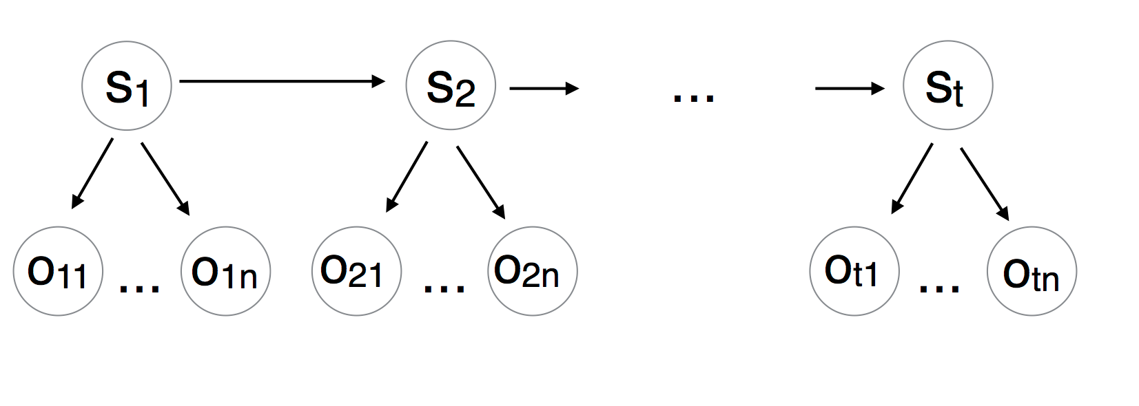
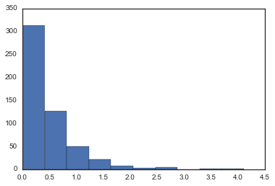
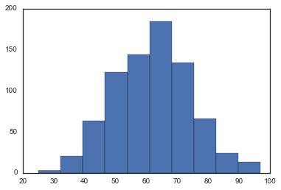
Hidden Markov Model
Hidden States
Normal | Fog-Rain | Snow
Fog-Snow | Fog | Rain-Snow
Fog-Rain-Snow | Rain | Thunderstorm
Precipitation –
Log Normal
Observations
Humidity –
Gaussian
Mean Temperature | Mean Dew Point
Mean Humidity | Mean Wind Speed
Precipitation | Mean Visibility
Mean Sea Level Pressure
Notes:
- Weather is often very hard to predict even when we have a sense of the weather measures
We have attempted to model weather events based on weather measures using a second order HMM
9 hidden states representing weather events
7 continuous real-valued weather measures are our observations (all seven observed for each weather event)

Slide 15
Data
55 years of of daily weather data for Boston
Training set – 1st Jan 1960 to 31st Dec 2010
Test Set – 1st Jan 2011 to 31st Dec 2015
Notes:
Dataset – Weather measure data for Boston over the past 55 years
Training – first 50 years, test on the next 5 years
TP – tracked over the entire training period – studied its stationarity
EP – for each state – multivariate normal represents EP for the 7 observations made
The multivariate normal constructed from underlying gaussian and log-normal distributions representing each of the 7 real-valued weather measures
Results – overall inference accuracy of 65%
Specifically, inferred normal days, extreme events like thunderstorms and specific events like Fog
Model did less well on highly overlapping events like Rain, Rain-Snow, Fog-Snow etc. However, still considerable better than a naïve baseline.
Confusion matrix to represent nature of error (not all labels are equidistant; ordering exists)
Further improve with - a third order model, better/more parameters, better EP/TP

